Slide 1

AI
We don’t just need a better way of doing the same things.
We need a whole new way to work!
Educational Friday – 21.04.2023
Notes:
Obserwowany przez nas wszystkich dynamiczny rozwój sztucznej inteligencji powinien skłaniać nas , informatyków do zasadniczo odmiennego podejścia do budowy nowych rozwiązań informatycznych, których zadaniem jest wspieranie procesów biznesowych.
Tak jak przesłanie sentencji zawartej na tym slajdzie, zamiast usprawnianie tego jak coś dzisiaj robimy powinniśmy zasadniczo zmienić sposób podejścia do tej pracy.
Pomóc w tym mogą rozwiązania sztucznej inteligencji, w których posiadane już dane operacyjne, te historyczne i stale napływające w połączeniu z istniejącymi i customizowanymi modelami sztucznej inteligencji mogą i powinny stanowić podstawę do poprawy automatyzacji działań, budowy rozwiązań dla klientów rzeczywiście selfservice, implementacji systemów które optymalizują procesy decyzyjne i operacyjne.

Slide 2
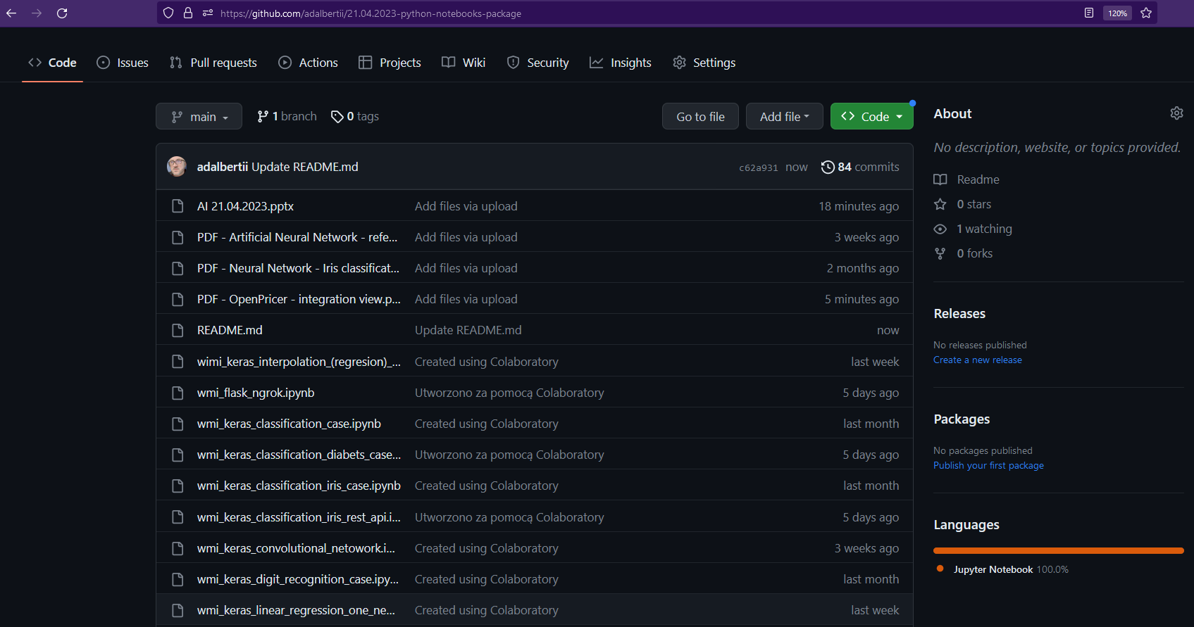
Agenda
Artificial Neural Network:
properties of an artificial neuron
neural network architecture
mathematical foundations of the functioning of artificial neural networks
the process of learning and validating neural network models
hyperparameters of the neural network learning process
the process of preparing data for learning and calibrating a neural network model
Workshop:
Go language Neural Network
Colab notebook’s (with Python language)
Notes:
Dziedzina sztucznej inteligencji to bardzo rozległy, interdyscyplinarny obszar zagadnień.
Dzisiejsze spotkanie inicjuje cykl workshopów- których celem jest przybliżenie tej tematyki.
Docelowo chcemy korzystać z niesamowitych osiągnięć naukowców i inżynierów. Korzystać z modeli sztucznych inteligencji do budowy nowoczesnych rozwiązań informatycznych.
Aby to było możliwe musimy umieć się odnaleźć w tej dziedzinie, wiedzieć z czego i w jaki sposób można skorzystać. Rozumieć jak takie modele funkcjonują, znać ich zalety i ograniczenia.
Dzisiaj omówimy tylko:
Po teoretycznych rozważaniach przejdziemy do budowy przykładowych modeli sztucznej inteligencji.
W doborze przykładów kierowałem się przede wszystkim prostotą.
Bardziej złożone zagadnienia, bardziej złożone modele będą przedmiotem kolejnych workshopów

Slide 3
Agenda for future workshops
Artificial intelligence continuation :
Recurential Neural Network - implementation
Convoultional Neural Network - implementation
Transfer learning - - implementation
Architecture of composed Neural Network
OpenAI
Azure cognitive services
Microsoft 365 Copilot
customization of existing neural network models,
building solutions with injected intelligence.

Slide 4
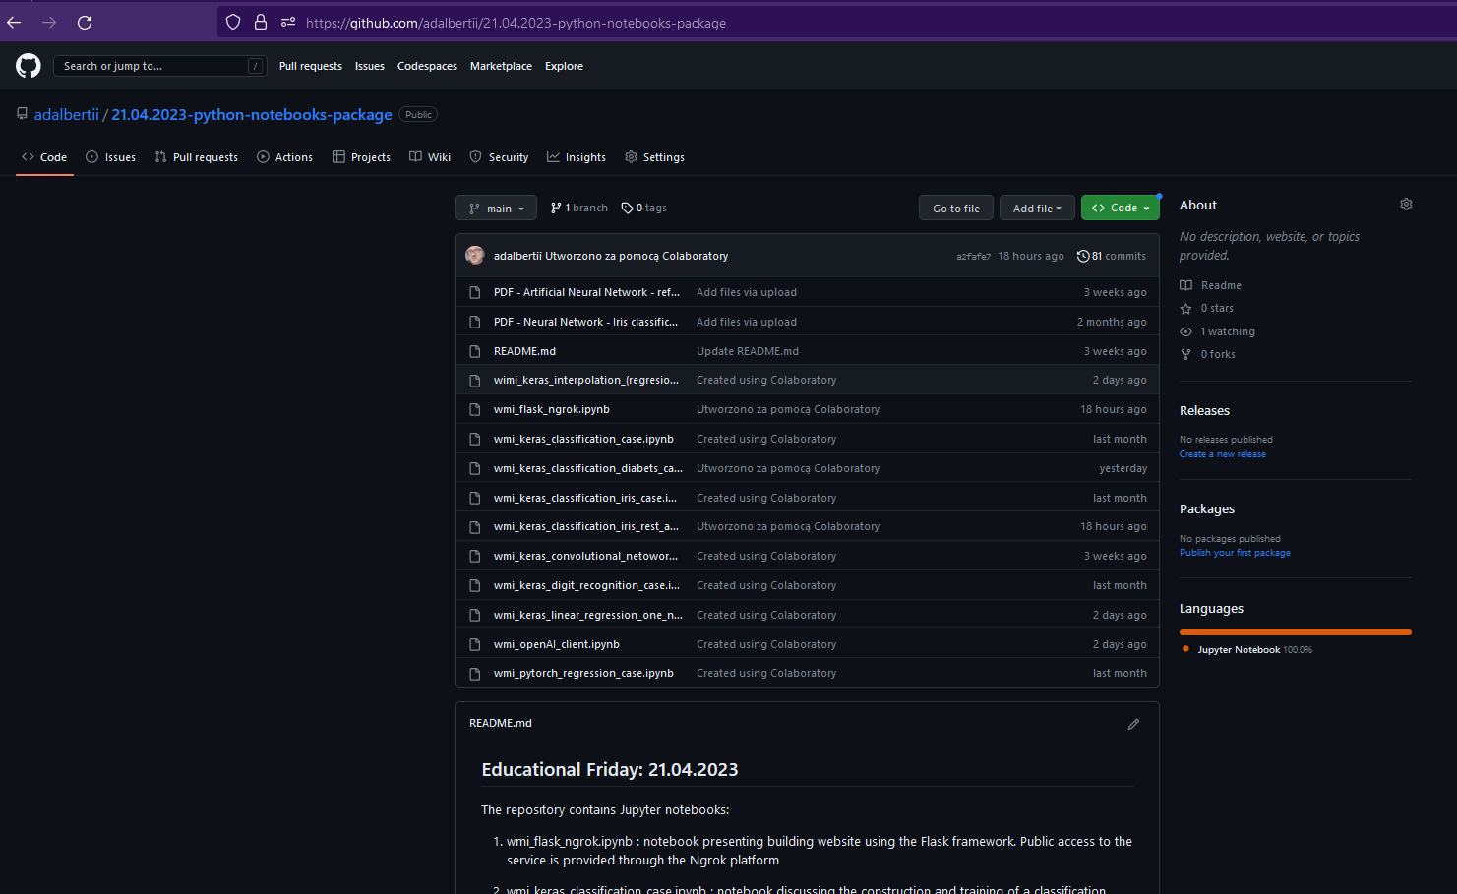
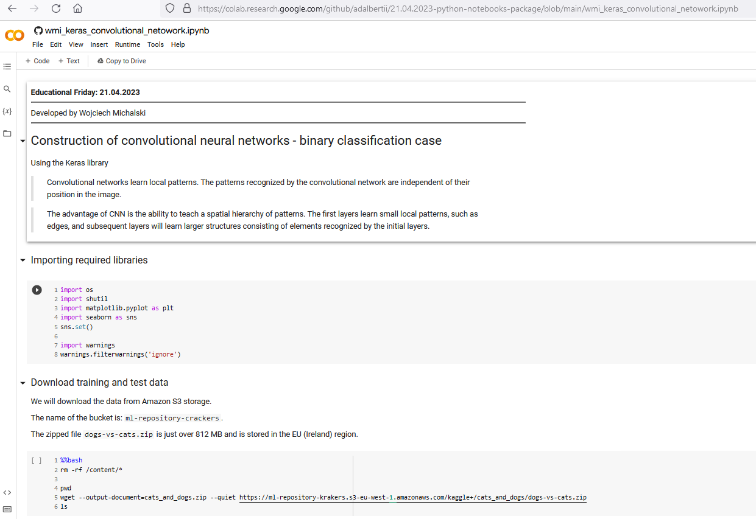
Workshop
Used tools and solutions:
CoLab,
Ngrok Platform,
OpenAI Platform,
Go language,
Python language,
Flask framework,
Keras, Pytorch, TensorFlow framework,
…

Slide 5
Workshop
The GitHub repository contains Jupyter notebooks:
1. wmi_flask_ngrok.ipynb : notebook presenting building website using the Flask framework. Public access to the service is provided through the Ngrok platform
2. wmi_keras_classification_case.ipynb : discussing the construction and training of a classification model intended for inferring whether a patient will develop diabetes
3. wmi_keras_classification_iris_case.ipynb : presenting the process of building and training a classification model and building an implementation package that will be used to build a REST service
4. wmi_keras_classification_iris_rest_api.ipynb - describing discussing the construction of a REST service using a trained classification model
5. wmi_keras_digit_recognition_case.ipynb - notebook presenting the process of building a neural network dedicated to recognizing handwritten numbers
6. wmi_keras_linear_regression_one_neuron_case.ipynb - he simplest case of a neural network built from a single neuran. The model can perform linear regression of the data
7. wmi_openAI_client.ipynb - an example of an implementation of the client layer of the REST service hosted by the Open AI service
8. wmi_pytorch_regression_case.ipynb - case of a neural network performing regressive estimation of housing prices
9. wmi_keras_convolutional_case.ipynb - an example of an implementation of convolutional network. The model can perform binary classification.
10. wmi_keras_classification_diabets_case_case.ipynb - diabetes risk assessment network. By performing binary classification.
Source code of an application written from scratch in GoLang with the necessary data that builds, trains and tests a neural network model

Slide 6
Artificial Neural Network
Features of artificial neural networks:
property of the universal approximator
learning, gaining knowledge from data
resistance to data disturbances
parallel architecture
adaptability
x1
Real object
x2
Y
x3
xN
Applications of artificial neural networks:
control of industrial processes
identification of systems
recognition and classification of patterns
prediction of time series
analysis of statistical data
sequence recognition
image and sound denoising and compression
technical and medical diagnostics
Forecasting
…
x1
Neural network Model
x2
Y’
x3
xN

Slide 7
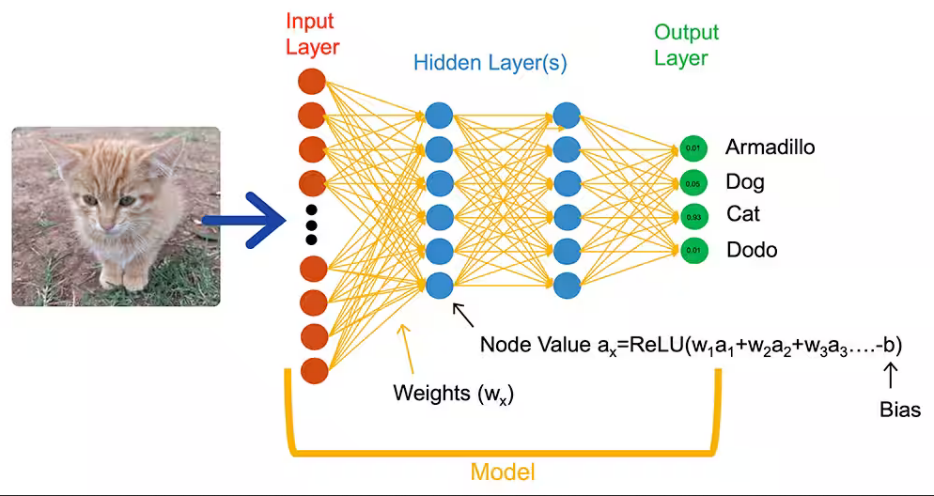
Artificial Neural Network
probability

Slide 8
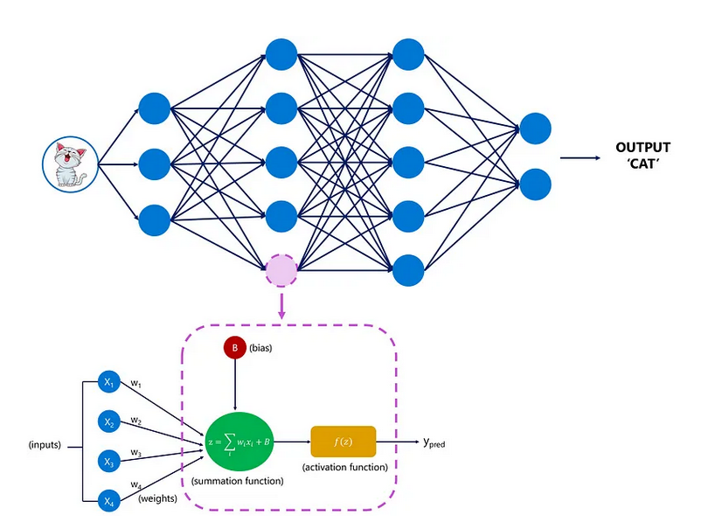
Artificial Neural Network

Slide 9
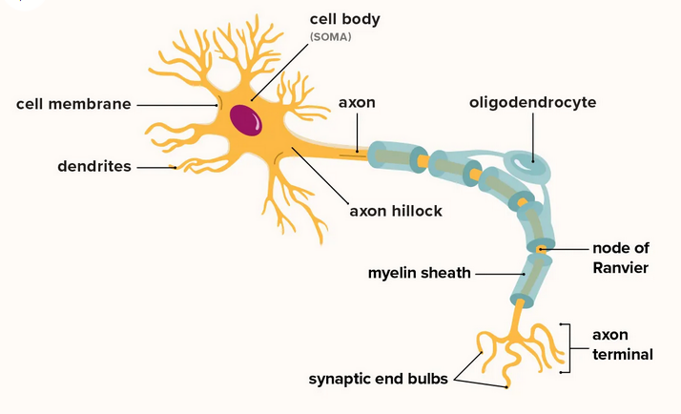
Artificial Neural Network

Slide 10
Artificial Neural Network
Prof. de Schutter - neuron model (so-called Purkinje cells):
the model referred to electrical systems which, according to the research of Hodkin and Huxley (Nobel Prize 1 in 1963) model the bioelectrical activity of individual fibers (dendrites and axon) and the cell membrane of the neuron body.
the results of Neher and Sakmann's research (Nobel Prize in 1991) on the functioning of ion channels were also taken into account.
The most important parameters:
32,000 differential equations
8021 models of ion channels
19,200 parameters to be estimated when fine-tuning the model
exact description of the cell morphology (reconstructed using a microscope)
10 types of mathematical models of voltage-dependent new channels
1600 so-called Compartments (cell fragments treated as homogeneous structures containing specific chemical compounds in specific concentrations
Simulations of:
voltage changes
calcium ion flows

Slide 11
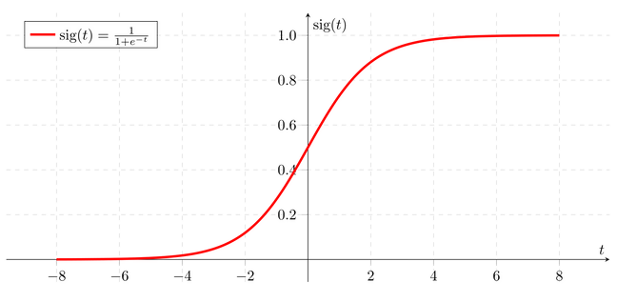
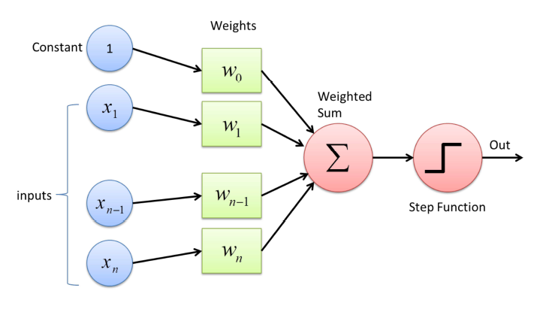
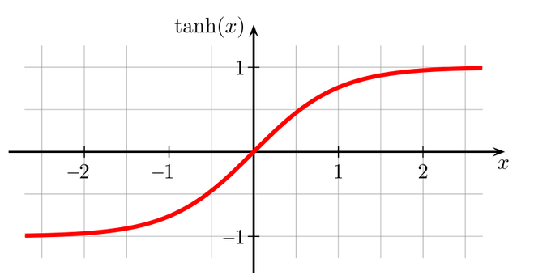
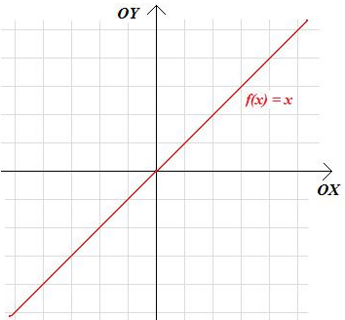
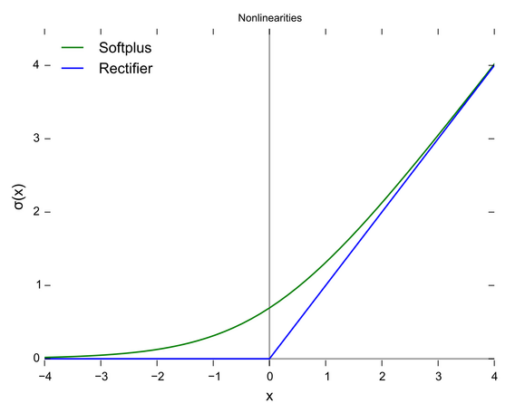
Artificial Neural Network
Activation function
SoftPlus(x) = log(1 + exp(x))

Slide 12
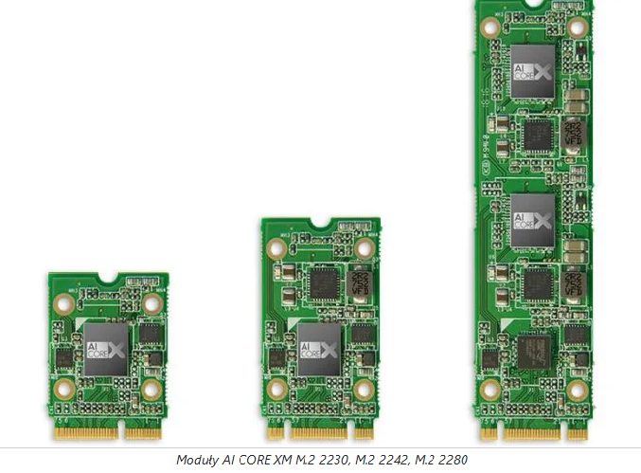
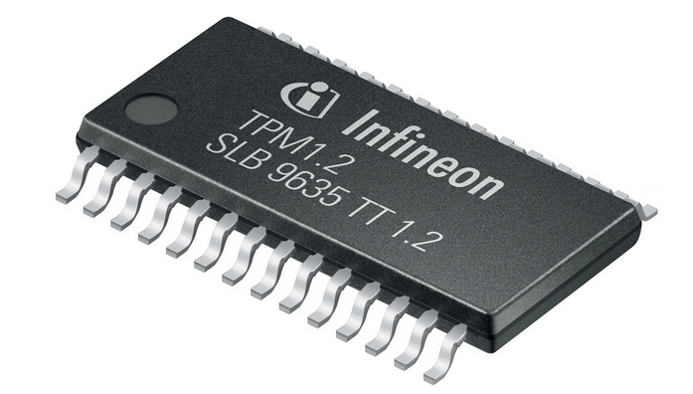
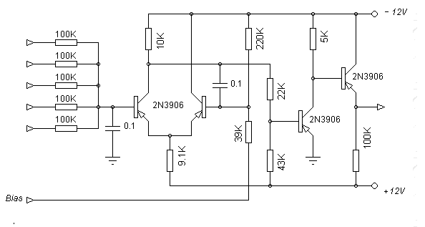
Artificial Neural Network
Neuromorphic integrated circuits
AI CORE X is a hardware implementation of neural networks with a convenient interface
inputs
output

Slide 13
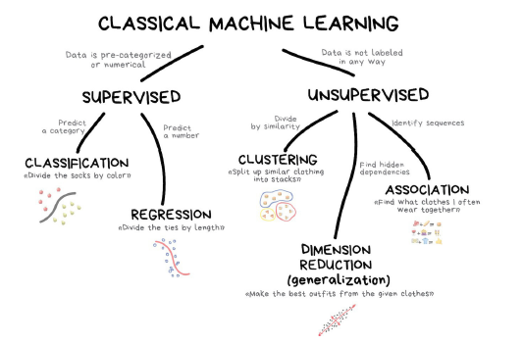
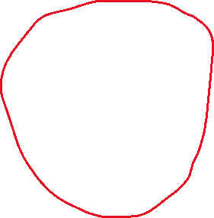
Artificial Neural Network
Machine learning can be categorized in the following four categories:
1. Supervised machine learning,
2. Semi-supervised machine learning,
3. Unsupervised machine learning,
4. Reinforcement learning.
☺

Slide 14
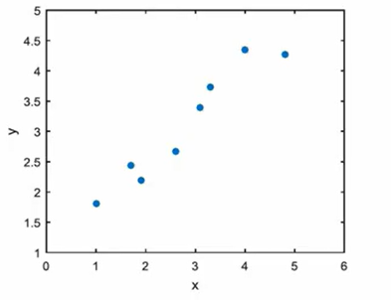
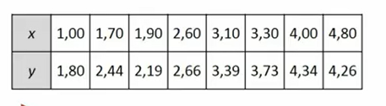
Artificial Neural Network
???
Function approximation - consists in approximating a certain function f(x) given in the form of a set of points (e.g. measurement points) with the function h(x) written with the formula h(x) = m * x + b

Slide 15
Artificial Neural Network
We want to find a solution that is a universal approximator:
h(x) = m *x + b
Activation function
Let's assume that:
we want the neuron to be responsible for the approximation task
at the input of this neuron there will be two signals x and b
let's take a linear function as the activation function
input weighting factor will be given by m
1
b
∑
y’
f(y’) =y’
x
m
h(x) = m *x + b

Slide 16
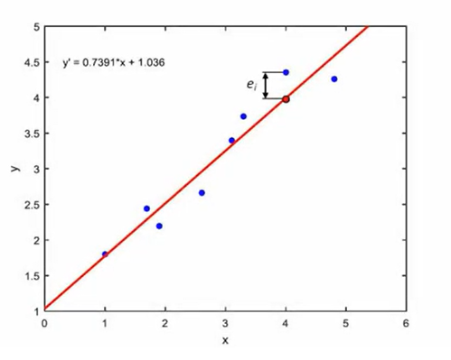
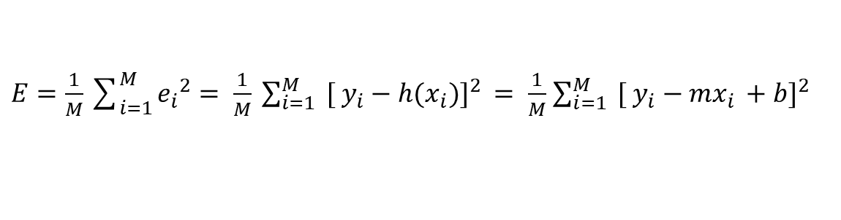

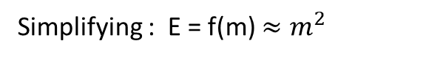
Artificial Neural Network
1 - measure of error
2 - optimization algorithm
3 - learning step
Approximation error
The measure of the approximation of the function f(x) by the function h(x) is most often the mean squared error (MSE):
$E=\frac{1}{M}\sum_{i=1}^{M}{{e_{i}}^{2}}= \frac{1}{M} {\sum_{i=1}^{M}{ [ y_{i}−h(x_{i}})]}^{2 }= \frac{1}{M}$ ${\sum_{i=1}^{M}{ [ y_{i}−mx_{i }}+b]}^{2}$
Simplifying : E = f(m) $≈m^{2}$
The goal of the approximation is search for such an m for which E -> min
$$m^{k+1}=m^{k}− µ\frac{d}{dm}E\left(m^{k}\right)$$
1
2

Slide 17
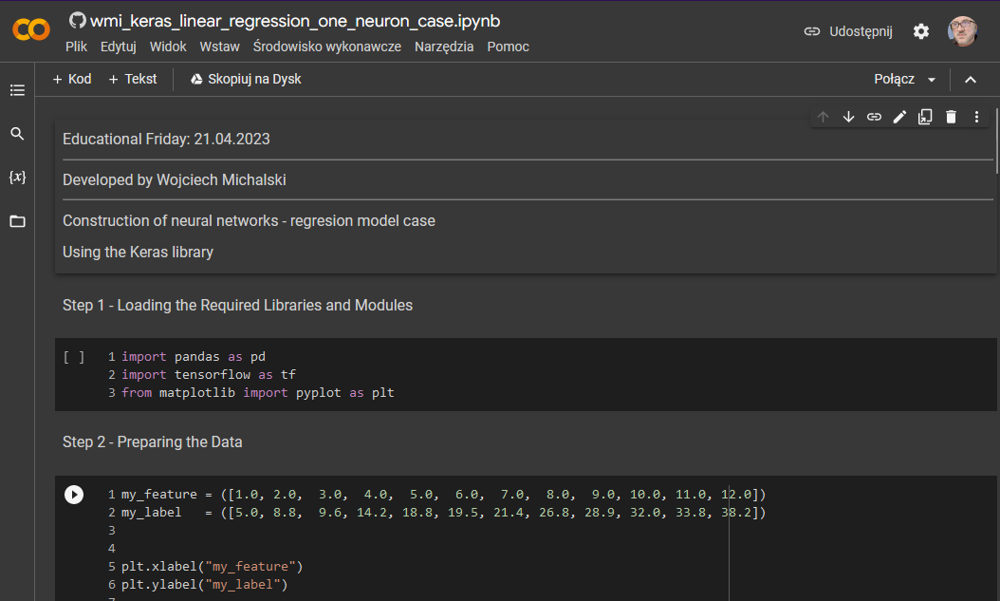
WorkShop - case number 1

Slide 18
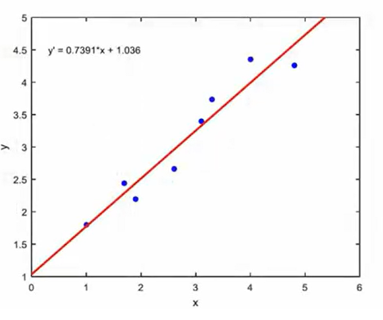
Artificial Neural Network
Linear approximation function
h(x) = m *x + b

Slide 19


Artificial Neural Network
$$m^{k+1}=m^{k}− µ\frac{d}{dm}E\left(m^{k}\right)$$
and the generalized form of this expression is as follows:
$$w^{k+1}=w^{k}− µ\frac{d}{dw}E\left(w^{k}\right)$$

Slide 20
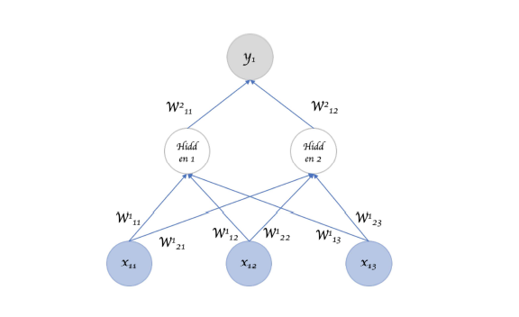
Artificial Neural Network

Slide 21
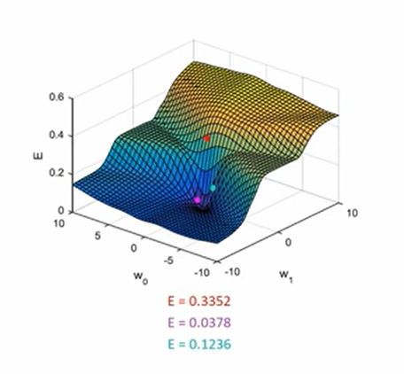
Artificial Neural Network

Slide 22
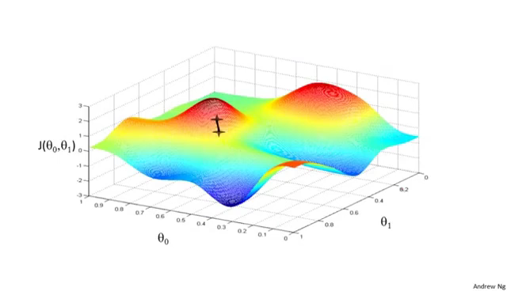
Artificial Neural Network

Slide 23
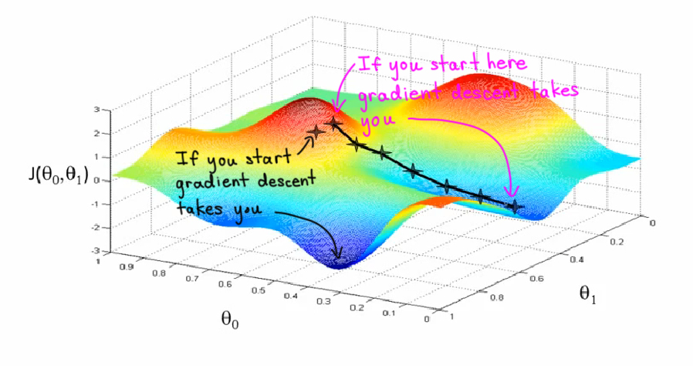
Artificial Neural Network
To zdjęcie, autor: Nieznany autor, licencja: CC BY-SA

Slide 24
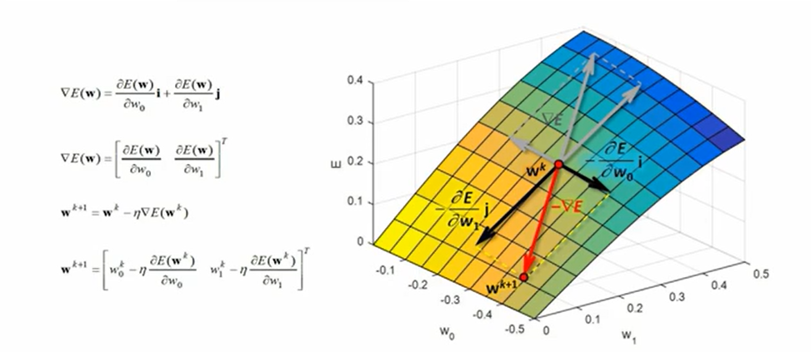
Artificial Neural Network

Slide 25
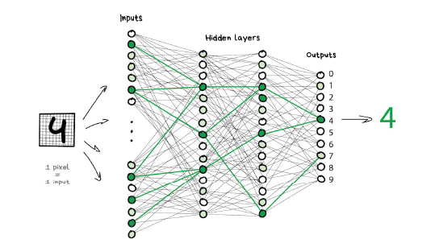
Artificial Neural Network

Slide 26
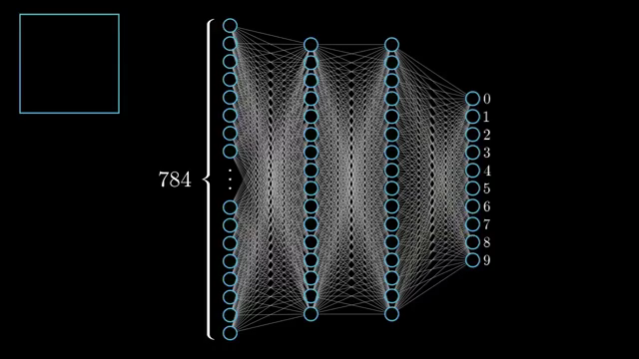
Artificial Neural Network
play

Slide 27
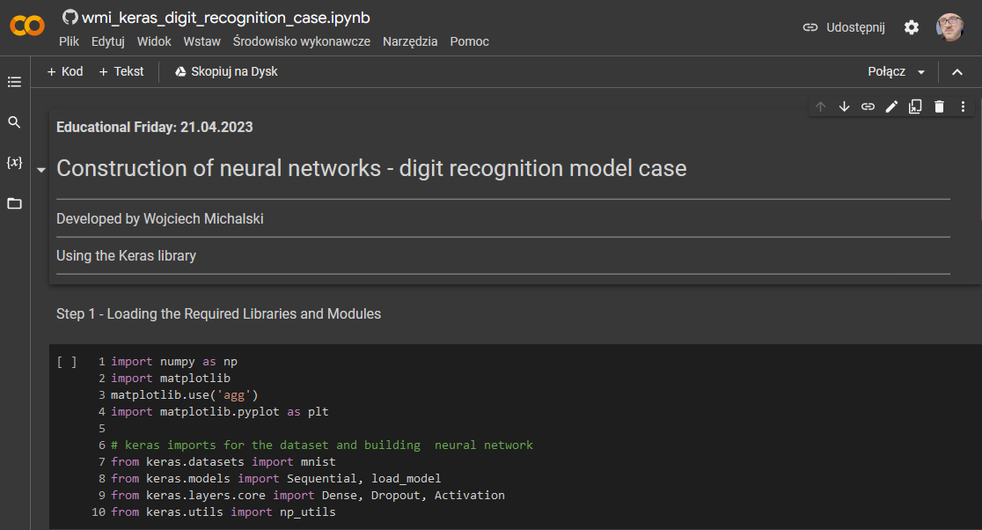
WorkShop - case number 2

Slide 28
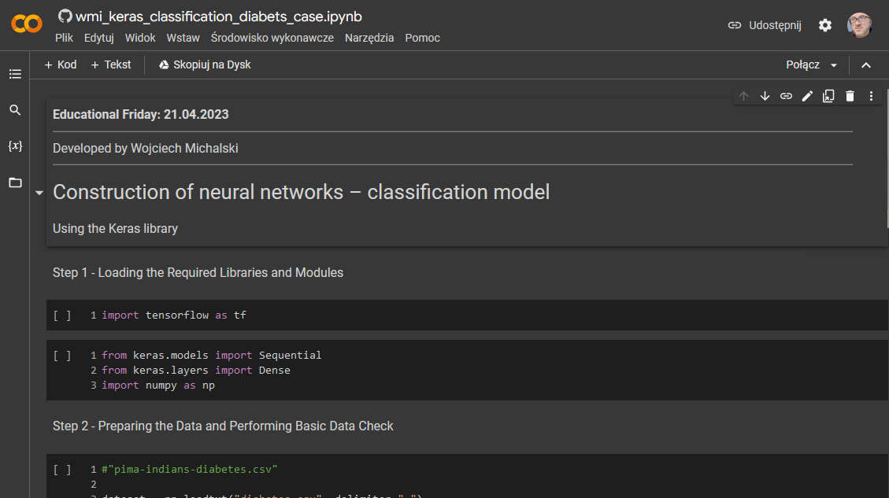
WorkShop - case number 3

Slide 29
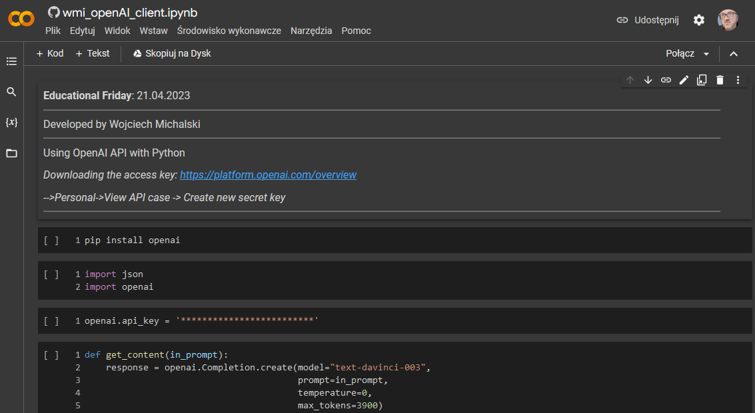
WorkShop - case number 4

Slide 30
WS - case number 4

Slide 31
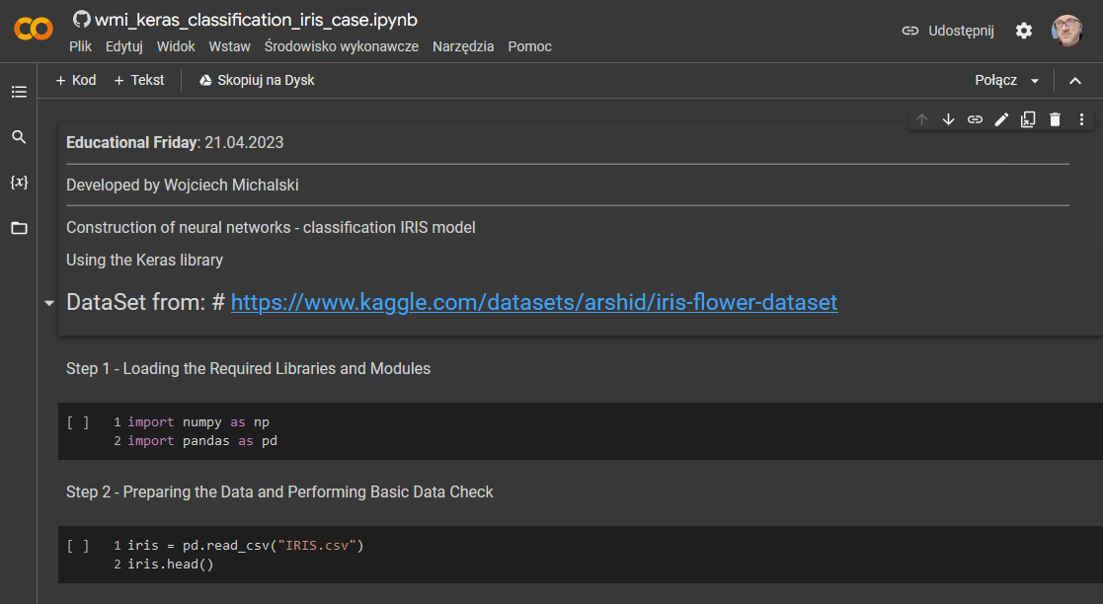
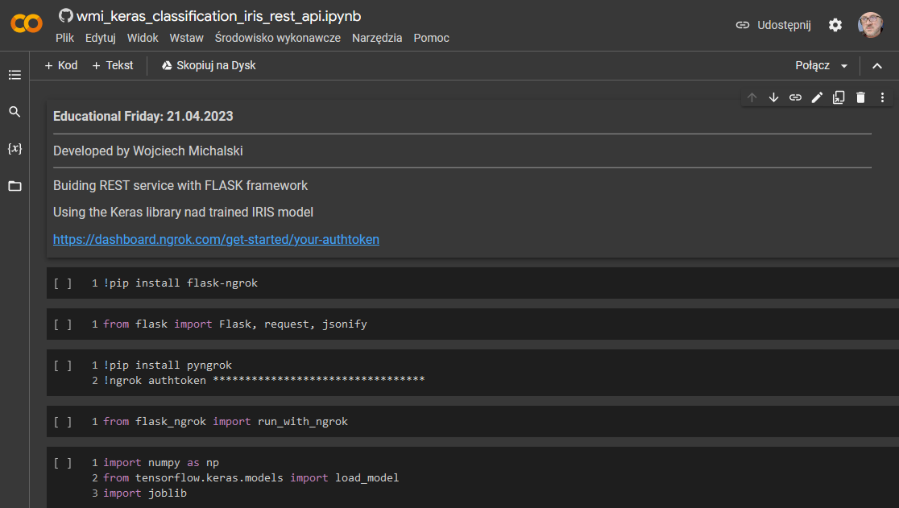
WorkShop - case number 5

Slide 32
Artificial Neural Network

Slide 33
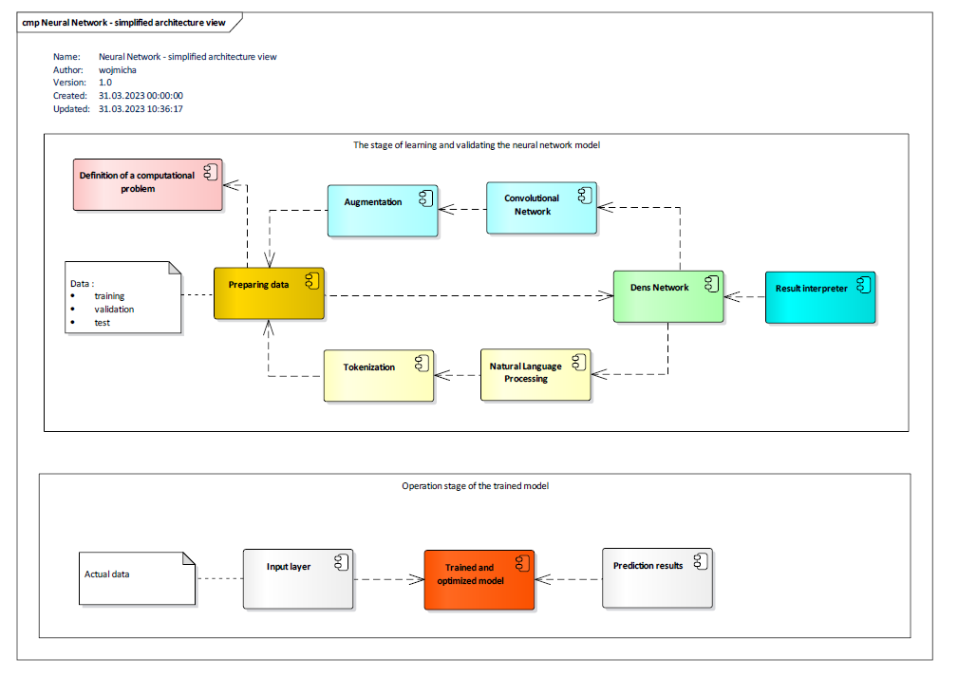
Artificial Neural Network

Slide 34
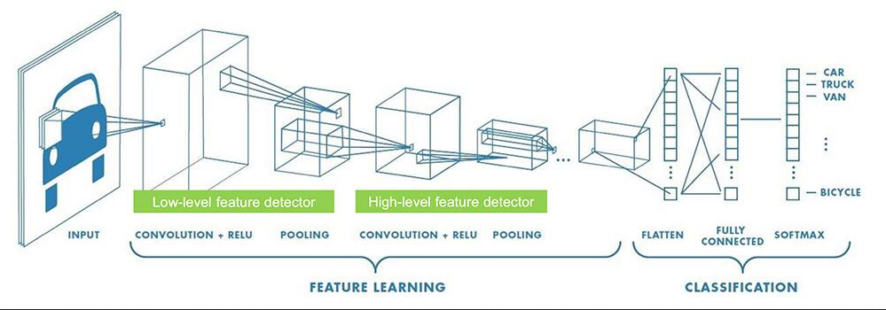
Artificial Neural Network

Slide 35
Artificial Neural Network
There are many other types of networks (about 50), such as convolutional networks, where the most important layers include:
Convolutional layer:
the number of filters that will extract the features,
the size of the kernel (the size of the convolution window, usually 3x3 or 5x5) and
the activation function (the most commonly used relu function).
MaxPooling2D layer - is a scaling operation. In simple terms, it consists in reducing dimensionality by passing through the image with extraction windows that return the maximum observed value in a given window (usually a 2x2 window size, with a shift step of 2), thus helping to reduce the size of the input data to the next layer by half, which significantly speeds up the process learning.
Flatten layer - flattens data in order to combine them with dense layers at the end of building the model. The last activation function will be the sigmoid function, which will return the probabilities of the image belonging to a particular class.

Slide 36
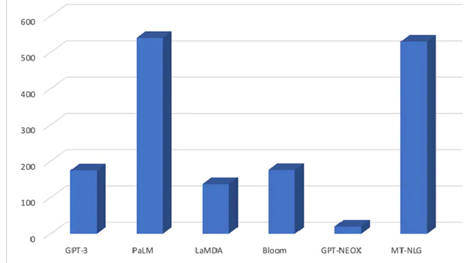
Artificial Neural Network
billion
The largest and most powerful language models (Large Language Models LLM ):
PaLM - Google
MT-NLG - Nvidia i Microsoft
GPT 3 - Open AI
Bloom - Appitierre stariup (Birmingham)
The human brain has 100 billion neurons, and each one can form synapses with 10,000 others.
An octopus' brain contains about 500 million neurons

Slide 37
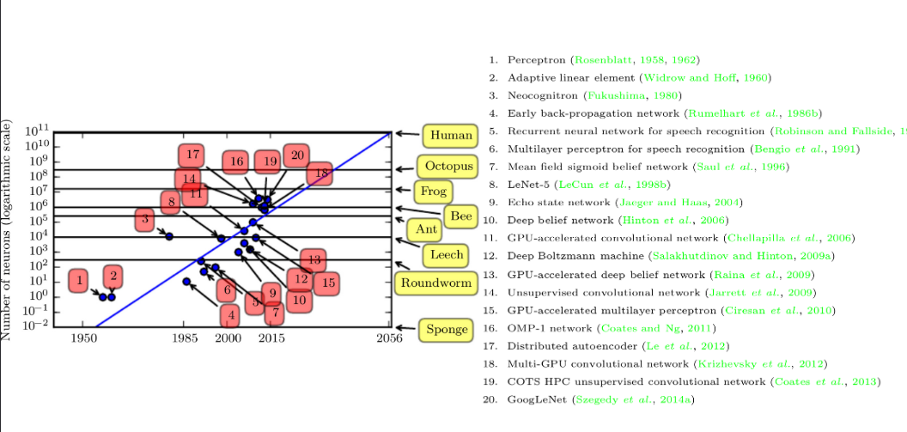
Artificial Neural Network
Notes:
Sponga – gąbczak
Roubdwarm – glista
Leech - pijawka

Slide 38
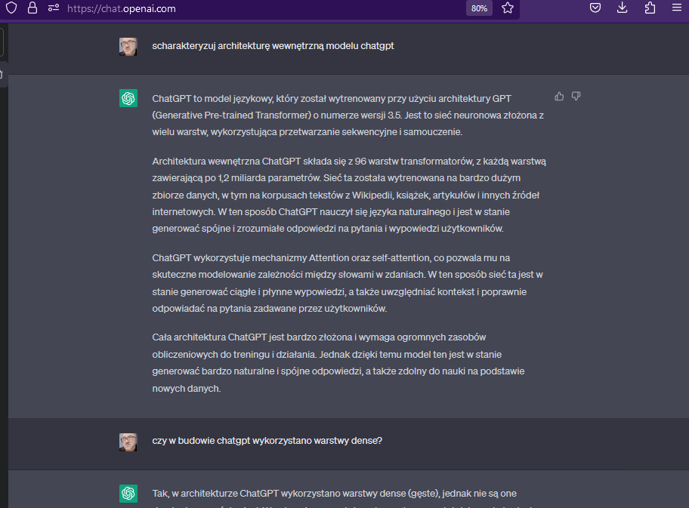
OpenAI
https://chat.openai.com/chat
1. Write a sql script that will create a table named PROFILE in the oracle database.
This table should contain the following fields: identifier, surname, first name.
2. Write a pyhon program that will host the rest service to write to this table.
Use the Flask framework. Niech ten program będzie nazwany wmi-serwis-Oracle
3. Dodaj pole wiek do tej tabeli PROFILE i uwzględnij tę zmianę struktury tabeli we wcześniej napisanym programie
4. Dodaj do programu nową metodę GET, która umożliwi wykonać zapytanie do tej tabeli.
Parametrem zapytania niech będzie pole identyfikator
5. Generate the documentation of the written service using the Swagger standard. Use flasgger library.
6. Containerize the written program using docker

Slide 39
Artificial Neural Network
Polski fizyk kwantowy prof. Andrzej Dragan.
„Rewolucja, która się teraz odbywa, to moim zdaniem największy przewrót cywilizacyjny, jaki kiedykolwiek nastąpił. Wynalezienie koła, maszyny parowej, czy internetu, to było nic w porównaniu z tym, co się dzieje w tym momencie z rewolucją tych sztucznych algorytmów, które teraz wytwarzamy.”
„To jest tylko kwestia kilku, kilkunastu, najdłużej kilkudziesięciu lat, kiedy będziemy pod każdym względem daleko w tyle za sztuczną inteligencją”

Slide 40
